Slide 1
Showcasing Volatility 3 by Detecting Sophisticated Malware
Andrew Case

Slide 2
Volatility 3
A complete rewrite of the Volatility framework
Architected from scratch with the lessons learned since ~2008
Designed to be flexible, scalable, and extendable
Will replace Volatility 2 in late April 2025

Slide 3

Why Memory Forensics?
Across platforms, memory-only payloads are often used by malware to avoid detection and hinder analysis
Disk and live forensics generally can find no traces of this malware
Volatile memory is the *only* place to determine that such malware is present and to fully investigate it
Microsoft Report: [1]

Slide 4
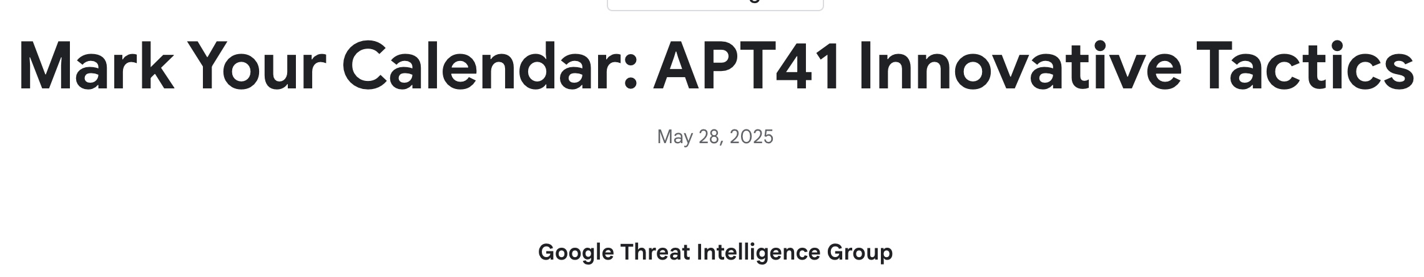
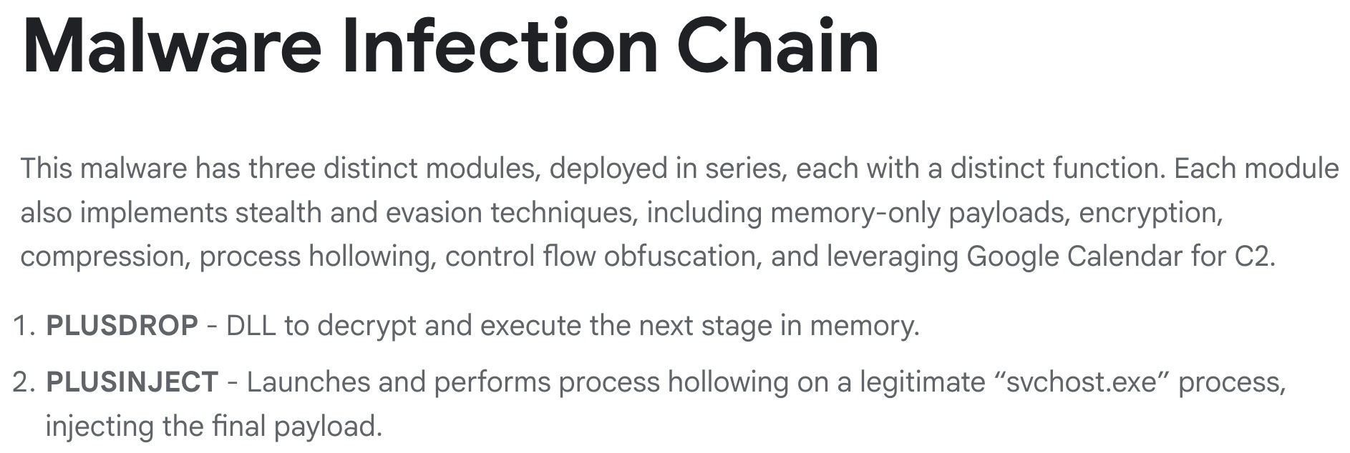
https://cloud.google.com/blog/topics/threat-intelligence/apt41-innovative-tactics

Slide 5
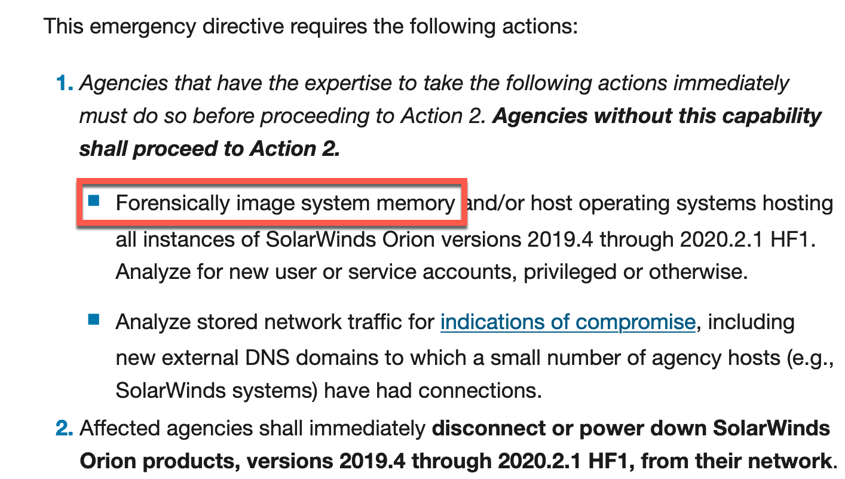
CISA Emergency Directives

Slide 6
Research Motivation
Traditional code injection techniques are noisy and detected by EDRs
… assuming the EDRs aren’t bypassed/disabled beforehand
Modern techniques specifically avoid creating the artifacts of the old methods
Volatility 2’s plugins were mostly written to target the older methods

Slide 7
Virtual Address Descriptors (VADs)
Describe the layout of process' virtual address space
Allow you to reserve or commit a contiguous range of memory that all have the same characteristics
PTEs are not created for reserved ranges and the memory cannot be accessed until it’s committed
Self-balancing AVL tree (for fast lookups)
What's in a VAD node
Range (start and end address)
Page protections
Full paths of DLLs and files that occupy the range

Slide 8
vadinfo Plugin
$ vol3 –f data.lime windows.vadinfo
PID Process Start VPN End VPN Tag Protection CommitCharge File
732 svchost.exe 0x1610000 0x168ffff VadS PAGE_READWRITE 20 N/A
732 svchost.exe 0x76f10000 0x7702efff Vad PAGE_EXECUTE_WRITECOPY 4 \Windows\System32\kernel32.dll
732 svchost.exe 0x1a90000 0x1b0ffff VadS PAGE_READWRITE 40 N/A
732 svchost.exe 0x1b10000 0x1c0ffff VadS PAGE_READWRITE 147 N/A
732 svchost.exe 0x77130000 0x772d9fff Vad PAGE_EXECUTE_WRITECOPY 14 \Windows\System32\ntdll.dll
732 svchost.exe 0x77030000 0x77129fff Vadm PAGE_EXECUTE_WRITECOPY 3 \Windows\System32\user32.dll
732 svchost.exe 0x7f0e0000 0x7ffdffff VadS PAGE_READONLY 0 N/A

Slide 9
Dynamically Loaded Libraries (DLLs)
Loaded automatically by the Windows loader for any libraries specified in a process’ IAT
Can be loaded explicitly at any time by code in the process space by calling LoadLibrary() or a derivative
LoadLibraryEx() – flexible, more options
LdrLoadDll() – native NT API
Any libraries loaded via these methods are recorded in the PEB’s _PEB_LDR_DATA structure

Slide 10
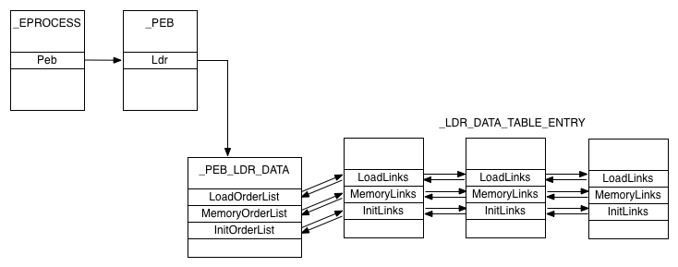
DLL Linked Lists

Slide 11
windows.dlllist plugin
$ vol3 –f data.lime windows.dlllist
PID | Process | Base | Size | Name. | Path | LoadTime
592 | csrss.exe | 0x7ff70db90000 | 0x7000 | csrss.exe | C:\Windows\system32\csrss.exe | 2017-11-22 17:21:57
592 | csrss.exe | 0x7ffc043f0000 | 0x1db000 | ntdll.dll | C:\Windows\SYSTEM32\ntdll.dll | 2017-11-22 17:21:57
592 | csrss.exe | 0x7ffc00840000 | 0x17000 | CSRSRV.dll | C:\Windows\SYSTEM32\CSRSRV.dll | 2017-11-22 17:21:57
592 | csrss.exe | 0x7ffc00820000 | 0x14000 | basesrv.DLL | C:\Windows\system32\basesrv.DLL | 2017-11-22 17:21:57
592 | csrss.exe | 0x7ffc00800000 | 0x16000 | winsrv.DLL | C:\Windows\system32\winsrv.DLL | 2017-11-22 17:21:57
592 | csrss.exe | 0x7ffc00cb0000 | 0x249000 | kernelbase.dll | C:\Windows\System32\kernelbase.dll | 2017-11-22 17:21:57
592 | csrss.exe | 0x7ffc01cb0000 | 0xae000 | kernel32.dll | C:\Windows\System32\kernel32.dll | 2017-11-22 17:21:57
592 | csrss.exe | 0x7ffc007e0000 | 0x1f000 | winsrvext.dll | C:\Windows\SYSTEM32\winsrvext.dll | 2017-11-22 17:21:58
592 | csrss.exe | 0x7ffc03e20000 | 0x14a000 | USER32.dll | C:\Windows\System32\USER32.dll | 2017-11-22 17:21:58

Slide 12
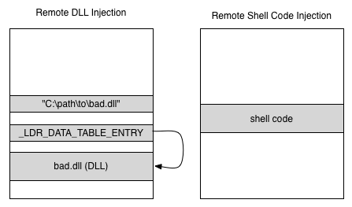
Traditional Injection Techniques Artifacts

Slide 13
Malfind Detecting Shellcode
$ python3 vol.py -f data.lime windows.malfind 6176 RasTls.exe 0x1e70000 0x1f6ffff VadS PAGE_EXECUTE_READWRITE 256 1
8b 0c 24 49 81 f7 da 57 ..$I...W
35 90 72 03 73 01 e8 b8 5.r.s...
e0 b8 12 18 81 c9 6f 59 ......oY
16 ca ba 13 32 2f f9 e9 ....2/..
01 00 00 00 e9 0d 44 ae ......D.
c6 26 4f 74 03 75 01 73 .&Ot.u.s
42 73 03 72 01 e8 7a 03 Bs.r..z.
7b 01 e9 e9 01 00 00 00 {.......
0x1e70000: mov ecx, dword ptr [esp]
0x1e70003: dec ecx
0x1e70004: xor edi, 0x903557da
0x1e7000a: jb 0x1e7000f
0x1e7000c: jae 0x1e7000f
0x1e7000e: call 0x149fe0cb

Slide 14
Reflective DLL Injection
Loading a DLL in memory without it ever existing on disk
Bypasses LoadLibrary() and the windows loader entirely
Thus it never enters the PEB lists in the first place
- … But there is still a VAD referencing the memory range!

Slide 15
Malfind vs Reflective Injection
$ vol3 -f data.lime windows.malfind
1928 lsass.exe 0x870000 0x9a7fff Vad PAGE_EXECUTE_READWRITE 0 MZ header
4d 5a 90 00 03 00 00 00 MZ......
04 00 00 00 ff ff 00 00 ........
b8 00 00 00 00 00 00 00 ........
40 00 00 00 00 00 00 00 @.......
00 00 00 00 00 00 00 00 ........
00 00 00 00 00 00 00 00 ........
00 00 00 00 00 00 00 00 ........
00 00 00 00 08 01 00 00 ........
0x870000: dec ebp
0x870001: pop edx
0x870002: nop
0x870003: add byte ptr [ebx], al
0x870005: add byte ptr [eax], al
0x870007: add byte ptr [eax + eax], al
0x87000a: add byte ptr [eax], al

Slide 16
$ python3 vol.py -f Emotet.lime windows.cmdline
PID Process Args
4 System Required memory at 0x20 is not valid (process exited?)
312 smss.exe \SystemRoot\System32\smss.exe
[snip] 4780 rundll32.exe C:\Windows\SysWOW64\rundll32.exe "C:\Users\Christian\AppData\Local\Wladsodhvynb\zfrwcmnngjl.jkk",Control_RunDLL
svchost.exe C:\Windows\system32\svchost.exe -k PrintWorkflow -s PrintWorkflowUserSvc
$ python3 vol.py -f Emotet.lime windows.malfind
4780 rundll32.exe 0x48d0000 0x48d2fff VadS PAGE_EXECUTE_READWRITE 3 1 Disabled MZ header
4d 5a 80 00 01 00 00 00 MZ......
04 00 00 00 ff ff 00 00. ........
b8 00 00 00 00 00 00 00 ........
40 00 00 00 00 00 00 00 @.......
4780 rundll32.exe 0x4900000 0x4900fff VadS PAGE_EXECUTE_READWRITE 1 1 Disabled Function prologue
55 89 e5 90 90 90 9a 11 U.......
00 90 04 33 00 89 ec 5d ...3...]
c3 48 83 ec 20 e8 e6 0f .H......
fe ff 48 83 c4 20 cb 00. ..H.....
0x4900000: push ebp
0x4900001: mov ebp, esp
[snip]

Slide 17
Process Hollowing
Start a new process (typically a well-known one like lsass.exe or svchost.exe) in suspended state
lsass.exe shows up in process listings, PEB, its full path on disk is %system%\lsass.exe as expected, etc.
Hollow the process
Free the memory block with the executable's base address, re-allocate a new one at the same address
Call NtUnmapViewOfFile to disassociate lsass.exe then overwrite instructions
Before resuming the thread, change the context to point at the new code

Slide 18
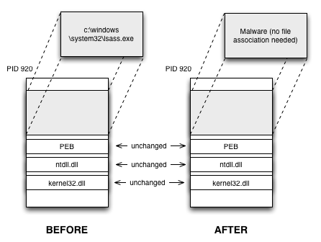
Visualizing Early Process Hollowing

Slide 19
lsass.exe Hollowing
$ vol3 -q -f data.lime windows.pslist | grep lsass.exe
680 624 lsass.exe 0x81e70020 19 342 0 False 2010-10-29 17:08:54.000000 N/A Disabled
868 668 lsass.exe 0x81c498c8 2 23 0 False 2011-06-03 04:26:55.000000 N/A Disabled
668 lsass.exe 0x81c47c00 4 65 0 False 2011-06-03 04:26:55.000000 N/A Disabled
$ vol3 -q -r pretty -f data.lime --filters "Start VPN",0x1000000 windows.vadinfo --pid 680 868 1928
| PID | Process | Start VPN | End VPN | Protection | CommitCharge | File |
* | 680 | lsass.exe | 0x1000000 | 0x1005fff | PAGE_EXECUTE_WRITECOPY | 1 | \WINDOWS\system32\lsass.exe |
* | 868 | lsass.exe | 0x1000000 | 0x1005fff | PAGE_EXECUTE_READWRITE | 2 | N/A |
* | 1928 | lsass.exe | 0x1000000 | 0x1005fff | PAGE_EXECUTE_READWRITE | 2 | N/A |

Slide 20
Automation
hollowfind plugin
Submitted to the 2016 Volatility Plugin Contest
https://cysinfo.com/detecting-deceptive-hollowing-techniques/
Compares PEB and VAD information:
File mapping in PEB vs no file & RWX in VAD
Disassembles the beginning bytes for spotting control flow redirection

Slide 21
windows.hollowprocesses vs Stuxnet
668 services.exe Unexpected protection (PAGE_EXECUTE_READWRITE) for DLL in the PEB's load order list (0x13f0000) with path C:\WINDOWS\system32\KERNEL32.DLL.ASLR.0360c5e2
940 svchost.exe Unexpected protection (PAGE_EXECUTE_READWRITE) for DLL in the PEB's load order list (0xd00000) with path C:\WINDOWS\system32\KERNEL32.DLL.ASLR.0360c8ee
868 lsass.exe Unexpected protection (PAGE_EXECUTE_READWRITE) for VAD hosting the process executable (0x1000000) with path <Non-File Backed Region>
868 lsass.exe Unexpected protection (PAGE_EXECUTE_READWRITE) for DLL in the PEB's load order list (0x1000000) with path C:\WINDOWS\system32\lsass.exe
1928 lsass.exe Unexpected protection (PAGE_EXECUTE_READWRITE) for VAD hosting the process executable (0x1000000) with path <Non-File Backed Region>
1928 lsass.exe Unexpected protection (PAGE_EXECUTE_READWRITE) for DLL in the PEB's load order list (0x1000000) with path C:\WINDOWS\system32\lsass.exe

Slide 22
windows.hollowprocess vs Cobalt Strike
$ vol3 -f data.lime windows.hollowprocesses
PID Process Notes
4636 svchost.exe Unexpected protection (PAGE_EXECUTE_READWRITE) for VAD hosting the process executable (0x880000) with path <Non-File Backed Region>
4636 svchost.exe Unexpected protection (PAGE_EXECUTE_READWRITE) for DLL in the PEB's load order list (0x880000) with path C:\Windows\SysWOW64\svchost.exe

Slide 23
windows.hollowprocess vs Non-RWX Hollowing
$ python3 vol.py -f data.lime windows.hollow
100 MTF.exe Unexpected protection (PAGE_READWRITE) for DLL in the PEB's load order list (0x610000) with path C:\Users\L490\AppData\Local\FXSEXT32\MTF.exe
796 MTF.exe Unexpected protection (PAGE_READWRITE) for DLL in the PEB's load order list (0x5c0000) with path C:\Users\L490\AppData\Local\FXSEXT32\MTF.exe
8924 AppVTerminator Unexpected protection (PAGE_READWRITE) for DLL in the PEB's load order list (0xa20000) with path C:\Users\L490\AppData\Local\KBDTH0\AppVTerminator.exe
3308 PBDTUQ.exe Unexpected protection (PAGE_READWRITE) for DLL in the PEB's load order list (0x550000) with path C:\Users\L490\AppData\Local\GameBarPresenceWriter\PBDTUQ.exe
6356 msvcr120_clr04 Unexpected protection (PAGE_READWRITE) for DLL in the PEB's load order list (0x580000) with path C:\Users\L490\AppData\Local\nlmgp\msvcr120_clr0400.exe
6236 autoconv.exe Unexpected protection (PAGE_READWRITE) for DLL in the PEB's load order list (0x4b0000) with path C:\WINDOWS\SysWOW64\mbsmsapi\autoconv.exe

Slide 24
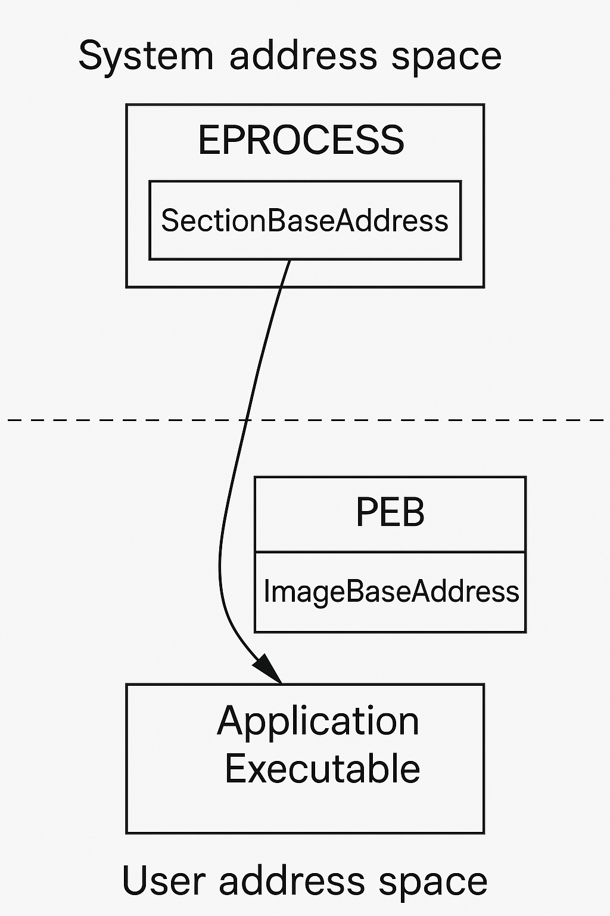
SectionBaseAddress vs ImageBaseAddress
The SectionBaseAddress is set during process creation to the load address of the main application executable
ImageBaseAddress inside the PEB is later set to the same address
Userland malware often changes ImageBaseAddress but cannot access SectionBaseAddress

Slide 25
windows.hollowprocess vs Base Address Tampering
$ python3 vol.py -f data.lime windows.hollow
612 manage-bde.exe The ImageBaseAddress reported from the PEB (0x7ff63f2d0000) does not match the process SectionBaseAddress (0x7ff6db320000)
612 manage-bde.exe There is no VAD starting at the base address of the process executable (0x7ff6db320000)
Sample infected with: https://github.com/AzAgarampur/PsForge

Slide 26
Summary So Far…
If an executable is at the beginning of a VAD (memory region), and it is not PAGE_EXECUTE_WRITECOPY OR does not map a file, then it will be detected
If malware tampers with the DLL data structures, it will be detected (windows.ldrmodules)
Bypasses?
Overwrite PE header?
Map injected malware as PAGE_EXECUTE_WRITECOPY?

Slide 27
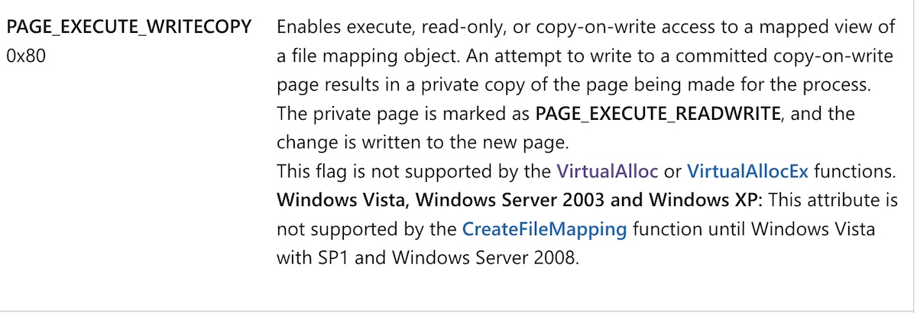
Manually Map PAGE_EXECUTE_WRITECOPY?
#define PAGE_NOACCESS 0x01
#define PAGE_READONLY 0x02
#define PAGE_READWRITE 0x04
#define PAGE_WRITECOPY 0x08
#define PAGE_EXECUTE 0x10
#define PAGE_EXECUTE_READ 0x20
#define PAGE_EXECUTE_READWRITE 0x40
#define PAGE_EXECUTE_WRITECOPY 0x80
#define PAGE_GUARD 0x100
#define PAGE_NOCACHE 0x200
#define PAGE_WRITECOMBINE 0x400
LPVOID WINAPI VirtualAlloc(
_In_opt_ LPVOID lpAddress,
_In_ SIZE_T dwSize,
_In_ DWORD flAllocationType,
_In_ DWORD flProtect
);
LPVOID WINAPI VirtualAllocEx(
_In_ HANDLE hProcess,
_In_opt_ LPVOID lpAddress,
_In_ SIZE_T dwSize,
_In_ DWORD flAllocationType,
_In_ DWORD flProtect
);

Slide 28
Manually Map PAGE_EXECUTE_WRITECOPY?
MapViewOfSection can be used to manually place a PAGE_EXECUTE_WRITECOPY VAD into a target process
Detections:
No file association/mapping
Not in the DLL lists
The code needs to run, likely by pointing a thread to it
https://github.com/Offensive-Panda/ProcessInjectionTechniques/tree/main/NtCreateSection_MapViewOfSection

Slide 29
Overwritten PE headers
It is somewhat common for malware to overwrite its PE header after loading
The header is never referenced again after load, so this is safe
Detecting VADs mapping executables with bad permissions relies on spotting the PE header at the VAD base
Solution: Threads tell us where code is executing!

Slide 30
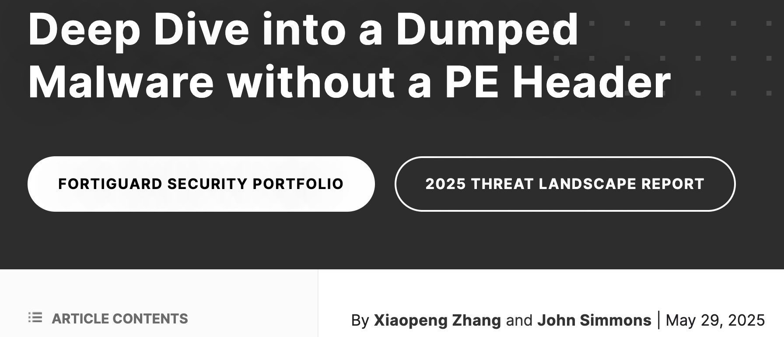
https://www.fortinet.com/blog/threat-research/deep-dive-into-a-dumped-malware-without-a-pe-header

Slide 31
Listing Threads
$ python3 vol.py -f data.lime -r pretty --filters PID,836 windows.threads
| PID | TID | StartAddress | StartAddressPath | Win32StartAddress | Win32StartAddressPath | CreateTime
* | 836 | 840 | 0xbf0574ed5518 | - | 0x7ff7d5554a90 | \Windows\System32\lsass.exe | 2022-11-10 21:03:12
* | 836 | 852 | 0x7ffcf185e3e0 | …\ntdll.dll | 0x7ff7d55521f0 | \Windows\System32\lsass.exe | 2022-11-10 21:03:12
* | 836 | 872 | 0x7ffcf185e3e0 | …\ntdll.dll | 0x7ffcee865240 | \Windows\System32\lsasrv.dll | 2022-11-10 21:03:12
* | 836 | 876 | 0x998d6ba7dac0 | - | 0x7ffcf17eb4a0 | \Windows\System32\ntdll.dll | 2022-11-10 21:03:12
* | 836 | 880 | 0xbf05746884d8 | - | 0x7ffcf17eb4a0 | \Windows\System32\ntdll.dll | 2022-11-10 21:03:12
* | 836 | 884 | 0xbf057465a4d8 | - | 0x7ffcf17eb4a0 | \Windows\System32\ntdll.dll | 2022-11-10 21:03:13
* | 836 | 4296 | 0x7ffcf185e3e0 | …\ntdll.dll | 0x7ffcef1fe910 | \Windows\System32\ucrtbase.dll | 2022-11-10 21:05:04
* | 836 | 2544 | 0xbf05747114d8 | - | 0x7ffcf17eb4a0 | \Windows\System32\ntdll.dll | 2022-11-10 21:53:12
* | 836 | 5624 | 0x998d7043b440 | - | 0x7ffcf17eb4a0 | \Windows\System32\ntdll.dll | 2022-11-10 22:03:08
* | 836 | 4216 | 0x7ffcf185e3e0 | …\ntdll.dll | 0x7ffcf17eb4a0 | \Windows\System32\ntdll.dll | 2022-11-10 22:04:44
* | 836 | 1320 | 0x7ffcf185e3e0 | …\ntdll.dll | 0x7ffcf17eb4a0 | \Windows\System32\ntdll.dll | 2022-11-10 22:05:24

Slide 32
Signs of a Suspicious Thread
One or both start addresses point to a memory region (VAD):
Not backed by a file
Not PAGE_EXEC_WRITECOPY
To a file path ending in .exe that is not the main application executable
Is suspended
Malware starts a process in suspended mode and never resumes the main thread

Slide 33
windows.suspicious_threads vs Various Malware
chrome.exe 5720 2616 Win32Start 0xc65410 <Non-File Backed Region> VAD at base address (0xbc0000) hosting this thread has an unexpected starting protection PAGE_NOACCESS
rundll32.exe 4288 4352 Win32Start 0x20fb25e14bc <Non-File Backed Region> VAD at base address (0x20fb25e0000) hosting this thread has an unexpected starting protection PAGE_EXECUTE_READWRITE
notepad.exe 6276 1480 Win32Start 0x249c2610000 <Non-File Backed Region> VAD at base address (0x249c2610000) hosting this thread has an unexpected starting protection PAGE_READWRITE
south.exe 5400 5468 Win32Start 0x22493430000 <Non-File Backed Region> This thread started execution in the VAD starting at base address (0x22493430000), which is not backed by a file
dllhost.exe 4024 4068 Win32Start 0x7ffc5495afb0 <Non-File Backed Region> This thread started execution in the VAD starting at base address (0x7ffc54920000), which is not backed by a file

Slide 34
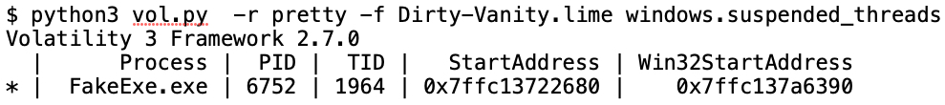

Detecting Dirty Vanity and its Suspended Thread [6]
Detecting the cloned process due to its suspended thread
Parent (PID 7472) and cloned child (PID 6752)

Slide 35
Process Ghosting and Transaction Tampering
Creating new VADs and threads leads to detection
Several code injection variants avoid this by directly loading malicious code, but having it marked/treated as “deleted”
Files marked as deleted cannot be scanned by AV/EDR
Handle creation blocked by OS
Transaction tampering can lead to AV/EDR seeing clean file contents on disk, but malicious content is in memory
Resources: [2-5]

Slide 36
Detecting Ghosting and Malicious Transactions
New windows.processghosting plugin
Detection flow:
Walk all processes, if the process file object is unset -> bad
Walk each mapped file (VAD), if exe|dll file object set as deleted -> bad
VAD -> if file object set as delete on close -> bad

Slide 37
windows.processghosting vs Transacted Hollowing [4]
$ python3 vol.py -r pretty -f data.lime windows.processghosting
PID | Process | FILE_OBJECT | DeletePending | DeleteOnClose |Base | Path
7132 | calc.exe | 0xfffebce3164 | 1 | N/A | 0x7ff660330000 | \Users\x\AppData\Local\Temp\TH725D.tmp
So many side effects!
Process called calc.exe but path is TH725D.tmp
Delete pending bit set on a process executable

Slide 38
windows.processghosting vs Process Ghosting [3]
$ python3 vol.py -r pretty -f data.lime windows.processghosting
| PID | Process | FILE_OBJECT | DeletePending | DeleteOnClose | Base | Path
* | 5600 | THCF0E.tmp | 0x0 | - | N/A | 0x7ff7a2460000 | \Users\x\AppData\Local\Temp\THCF0E.tmp
* | 5600 | THCF0E.tmp | 0xfffdb0e2174 | 1 | N/A | 0x7ff7a2460000 | \Users\x\AppData\Local\Temp\THCF0E.tmp

Slide 39
windows.processghosting vs Cobalt Strike
$ python3 vol.py -r pretty -f data.lime windows.processghosting
| PID | Process | FILE_OBJECT | DeletePending | DeleteOnClose | Base | Path
| 3704 | https-beacon.e | 0xdf01c28d9220 | N/A | 1 | 0x400000 | [snip]\https-beacon.exe

Slide 40
Conclusions
Traditional code injection and bypass techniques have evolved greatly in the last few years
New Volatility 3 plugins and detection algorithms catch these new techniques
https://volatilityfoundation.org/announcing-the-official-parity-release-of-volatility-3/
Detecting EDR Evasion Techniques:
https://www.youtube.com/watch?v=PmqvBe1LSZc&t=7s
https://www.volexity.com/resources <- ~20 page whitepaper

Slide 41
Questions? Comments?
Contact
acase@volexity.com
https://www.linkedin.com/in/andrewcase/
Social Media
@volexity, @volatility, @lsucyber, @attrc
Volatility 3 Parity Release Announcement
https://volatilityfoundation.org/announcing-the-official-parity-release-of-volatility-3/

Slide 42
References
[1] https://www.microsoft.com/security/blog/2022/07/27/untangling-knotweed-european-private-sector-offensive-actor-using-0-day-exploits/
[2] https://www.elastic.co/blog/process-ghosting-a-new-executable-image-tampering-attack
[3] https://github.com/hasherezade/process_ghosting
[4] https://github.com/hasherezade/transacted_hollowing
[5] https://attack.mitre.org/techniques/T1055/013/
[6] https://i.blackhat.com/EU-22/Thursday-Briefings/EU-22-Nissan-DirtyVanity.pdf

